Slide 1
Figure S3: Compound induced biomarker expression in primary human hepatocytes. The presented values (relative expression fold changes) represent mean values that were calculated from 1-3 independent experiments. The error bars illustrate the standard deviation of the independent experiments. A gene was considered to be up regulated when crossing the threshold line, which illustrates a significant increase of at least 2.5 fold change induction.
SULT1C2 expression was below the detection level for 1 donor at 8 µM and 40 µM.

Slide 2
SULT1C2 expression was below the detection level for 1 donor at all concentrations.

Slide 5
SULT1C2 expression was below the detection level for 1 donor at 2.6 nM and 64 nM.

Slide 6
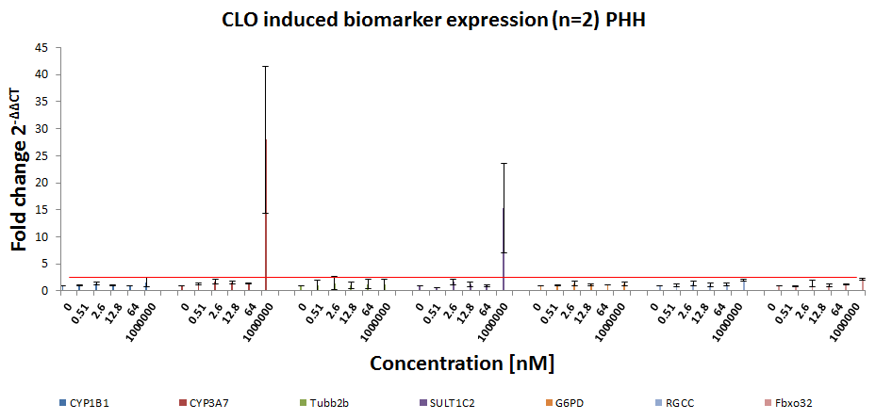

Slide 8
SULT1C2 expression was below the detection level for 1 donor at all concentrations.

Slide 11
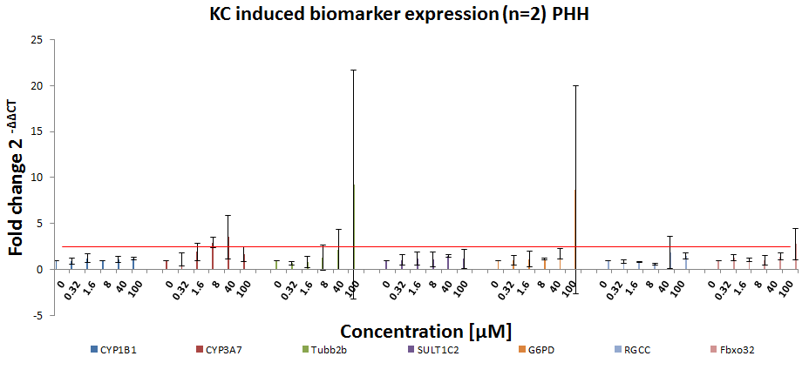

Slide 12
SULT1C2 expression was below the detection level for this donor.

Slide 13
SULT1C2 expression was below the detection level for 1 donor at 200 µM.

Slide 14
SULT1C2 expression was below the detection level for this donor at 20 pM, 0.51 nM, 2.6 nM and 100 nM.

Slide 15
SULT1C2 expression was below the detection level for 1 donor at all concentrations.

Slide 16
SULT1C2 expression was below the detection level for this donor at all concentrations.

Slide 18
SULT1C2 expression was below the detection level for 1 donor at 320 nM.

